Slide 1
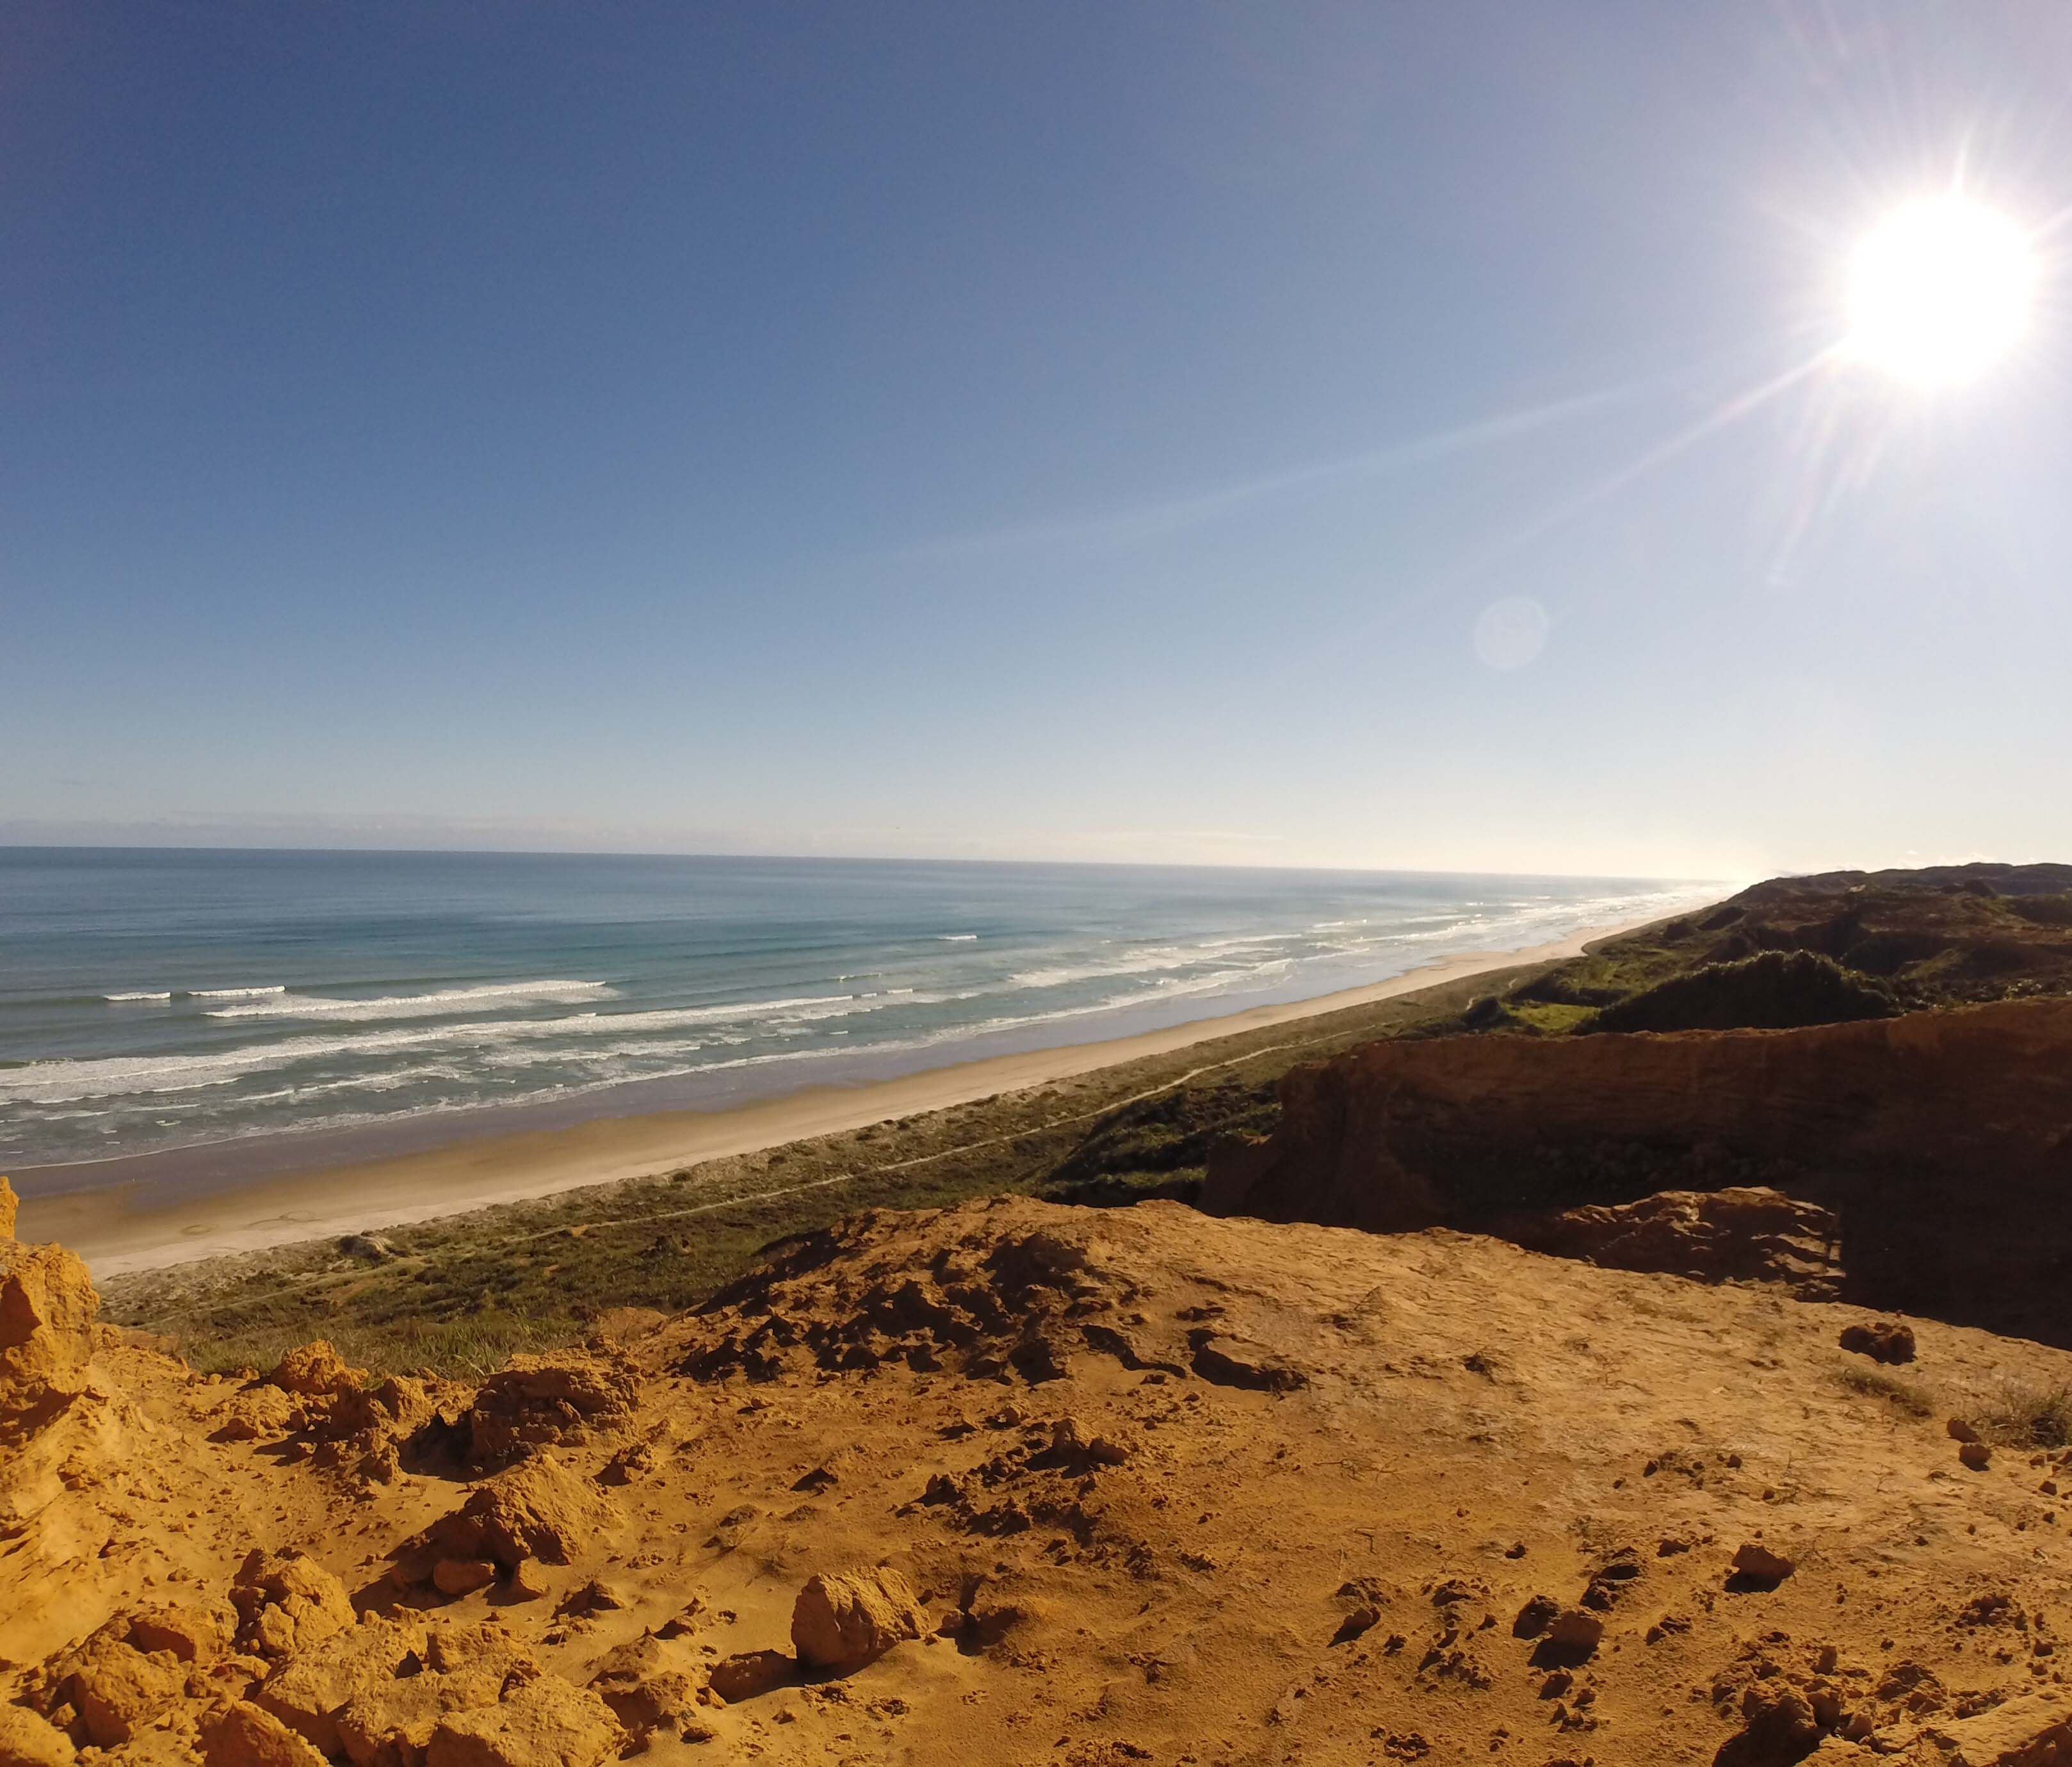
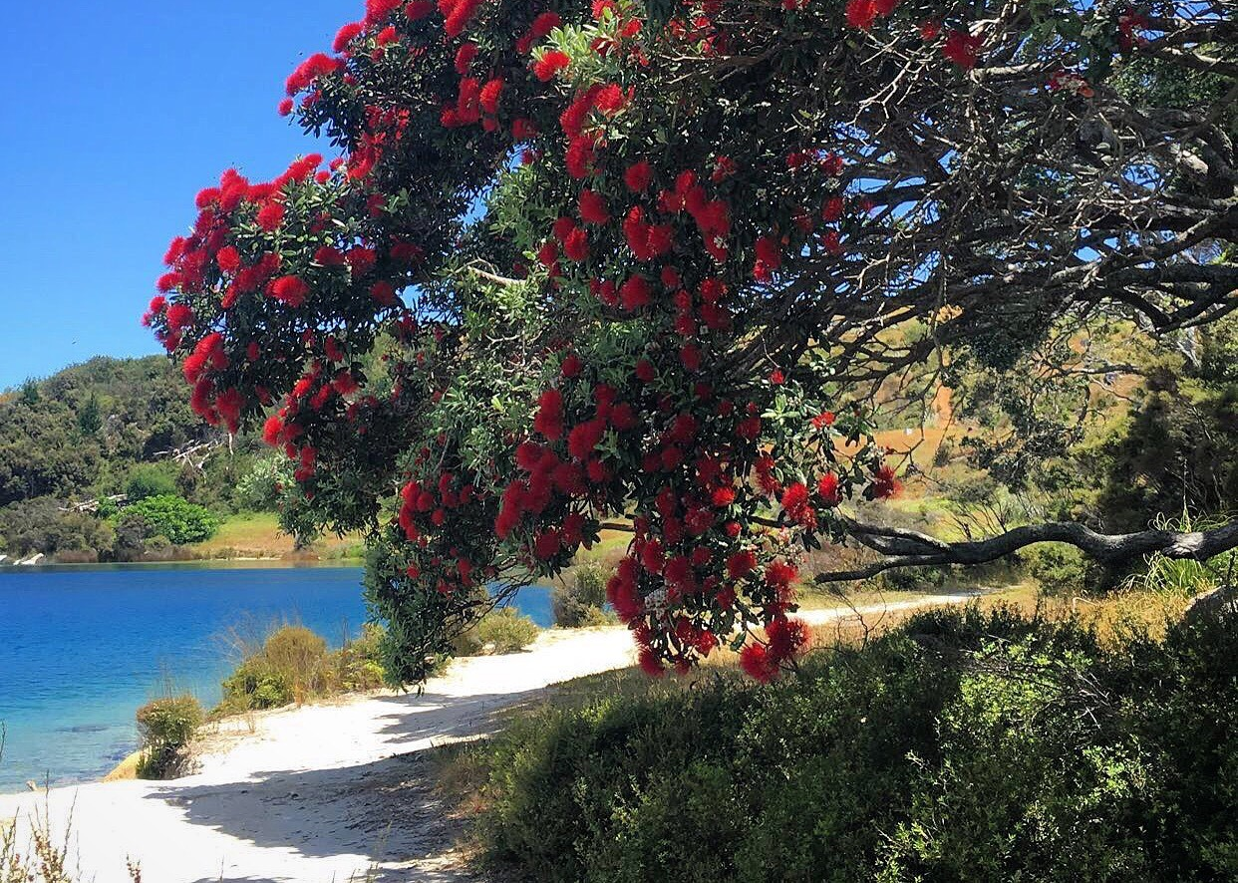
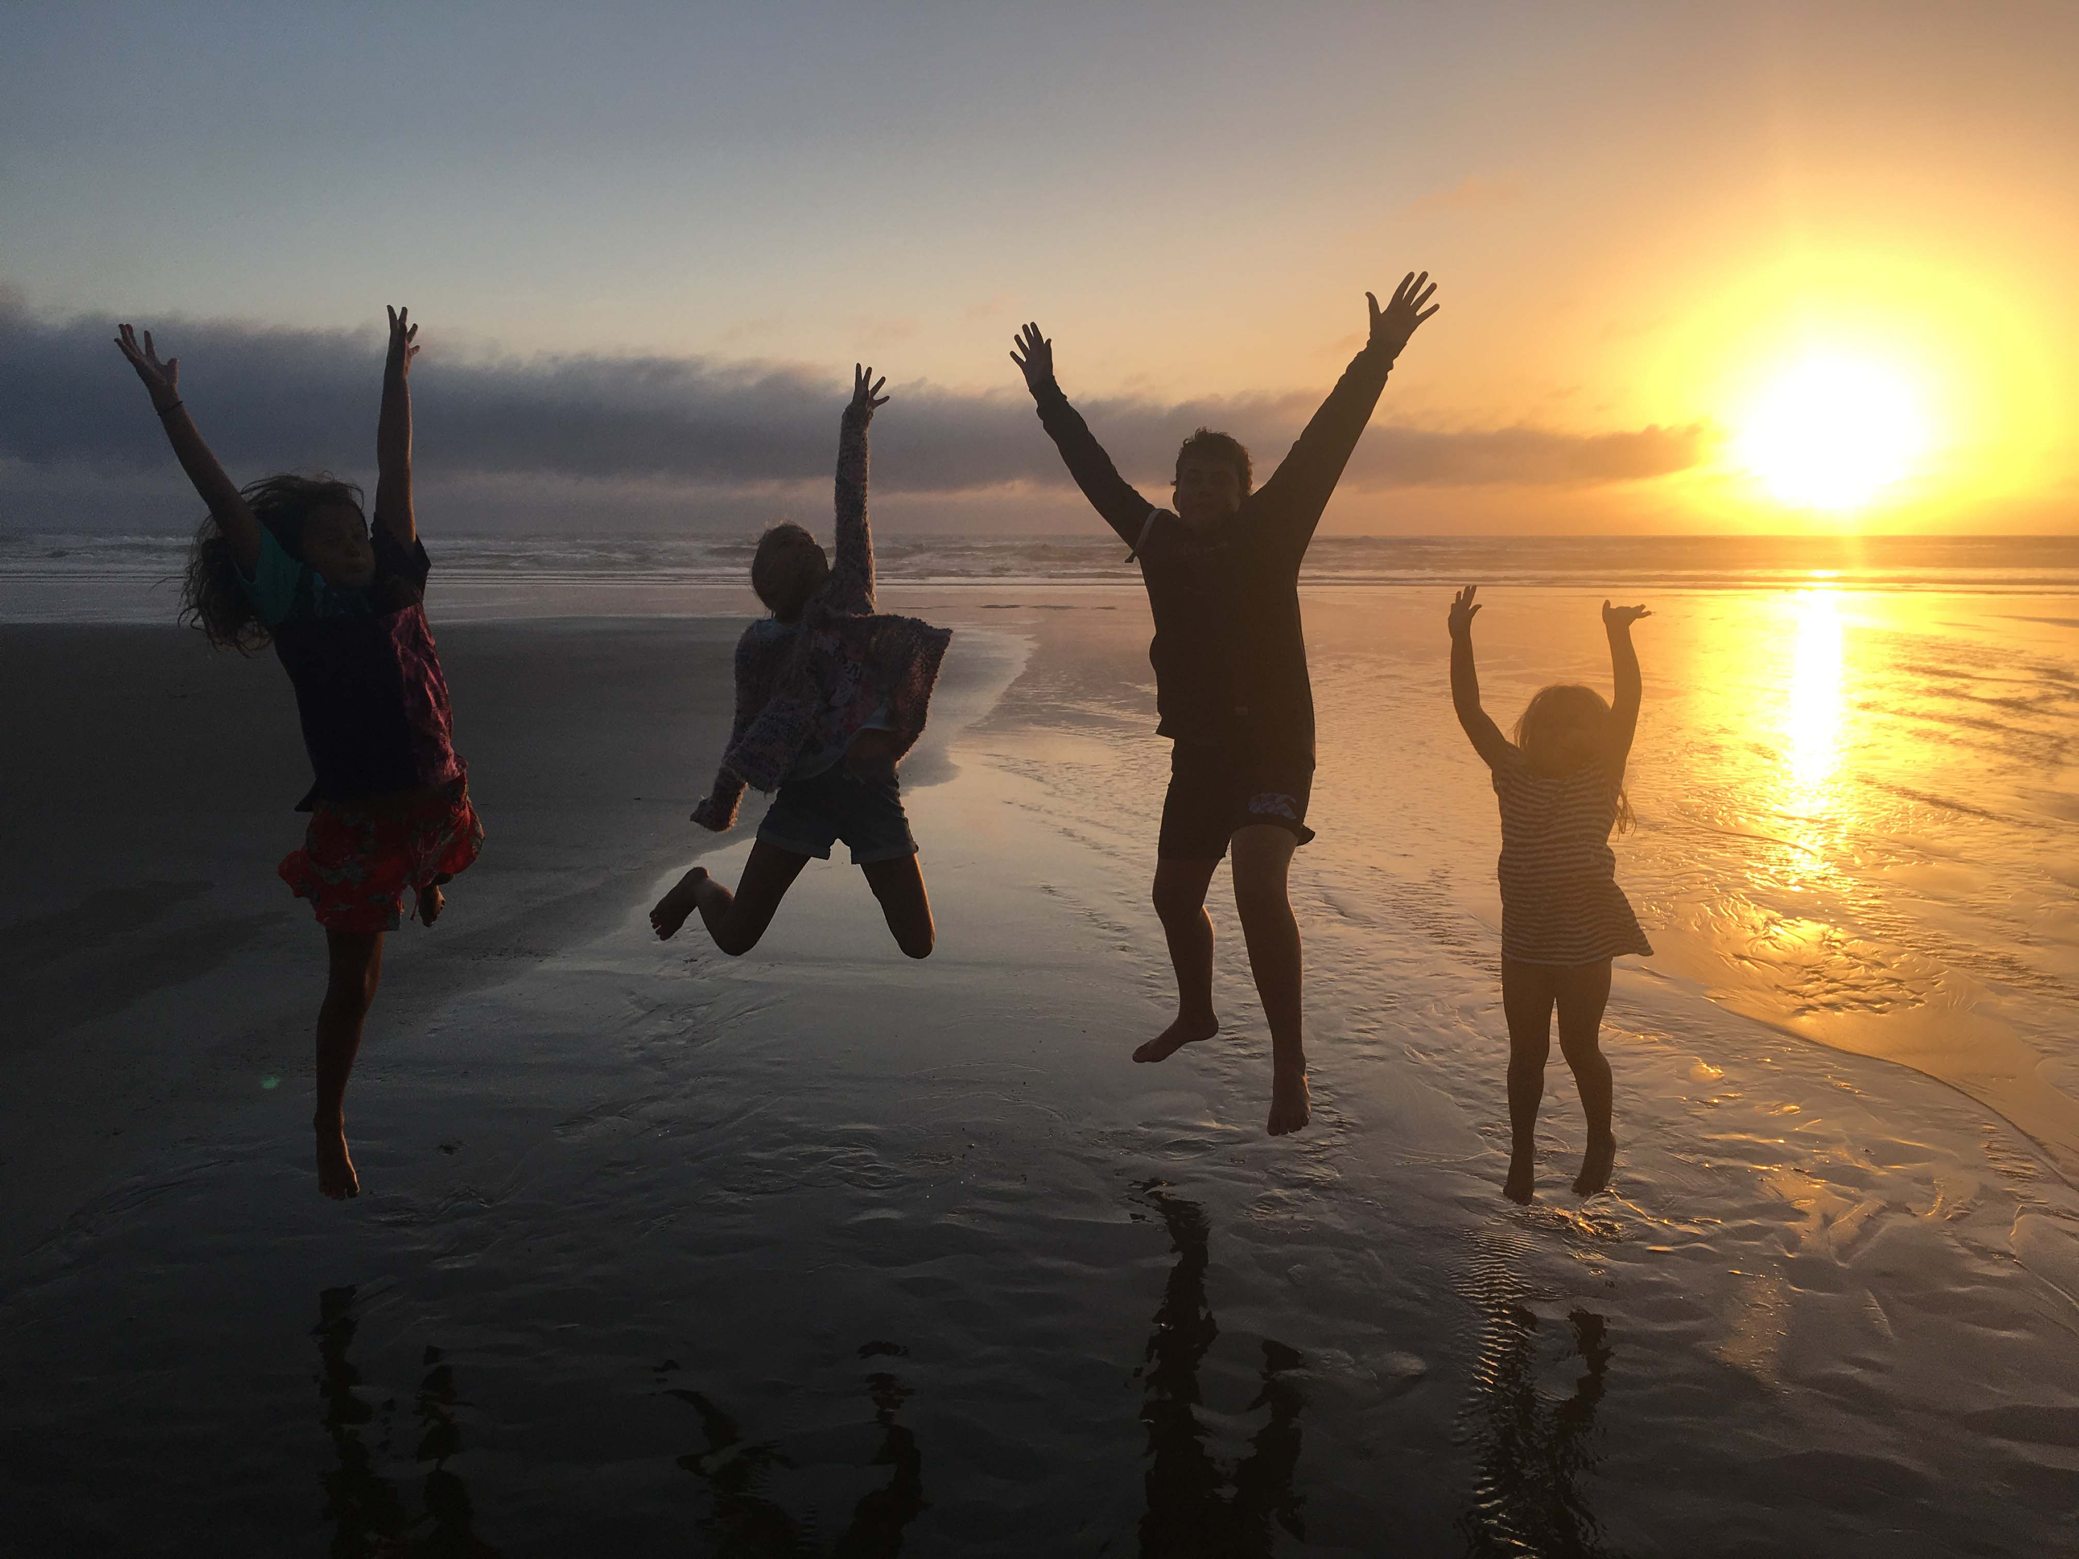
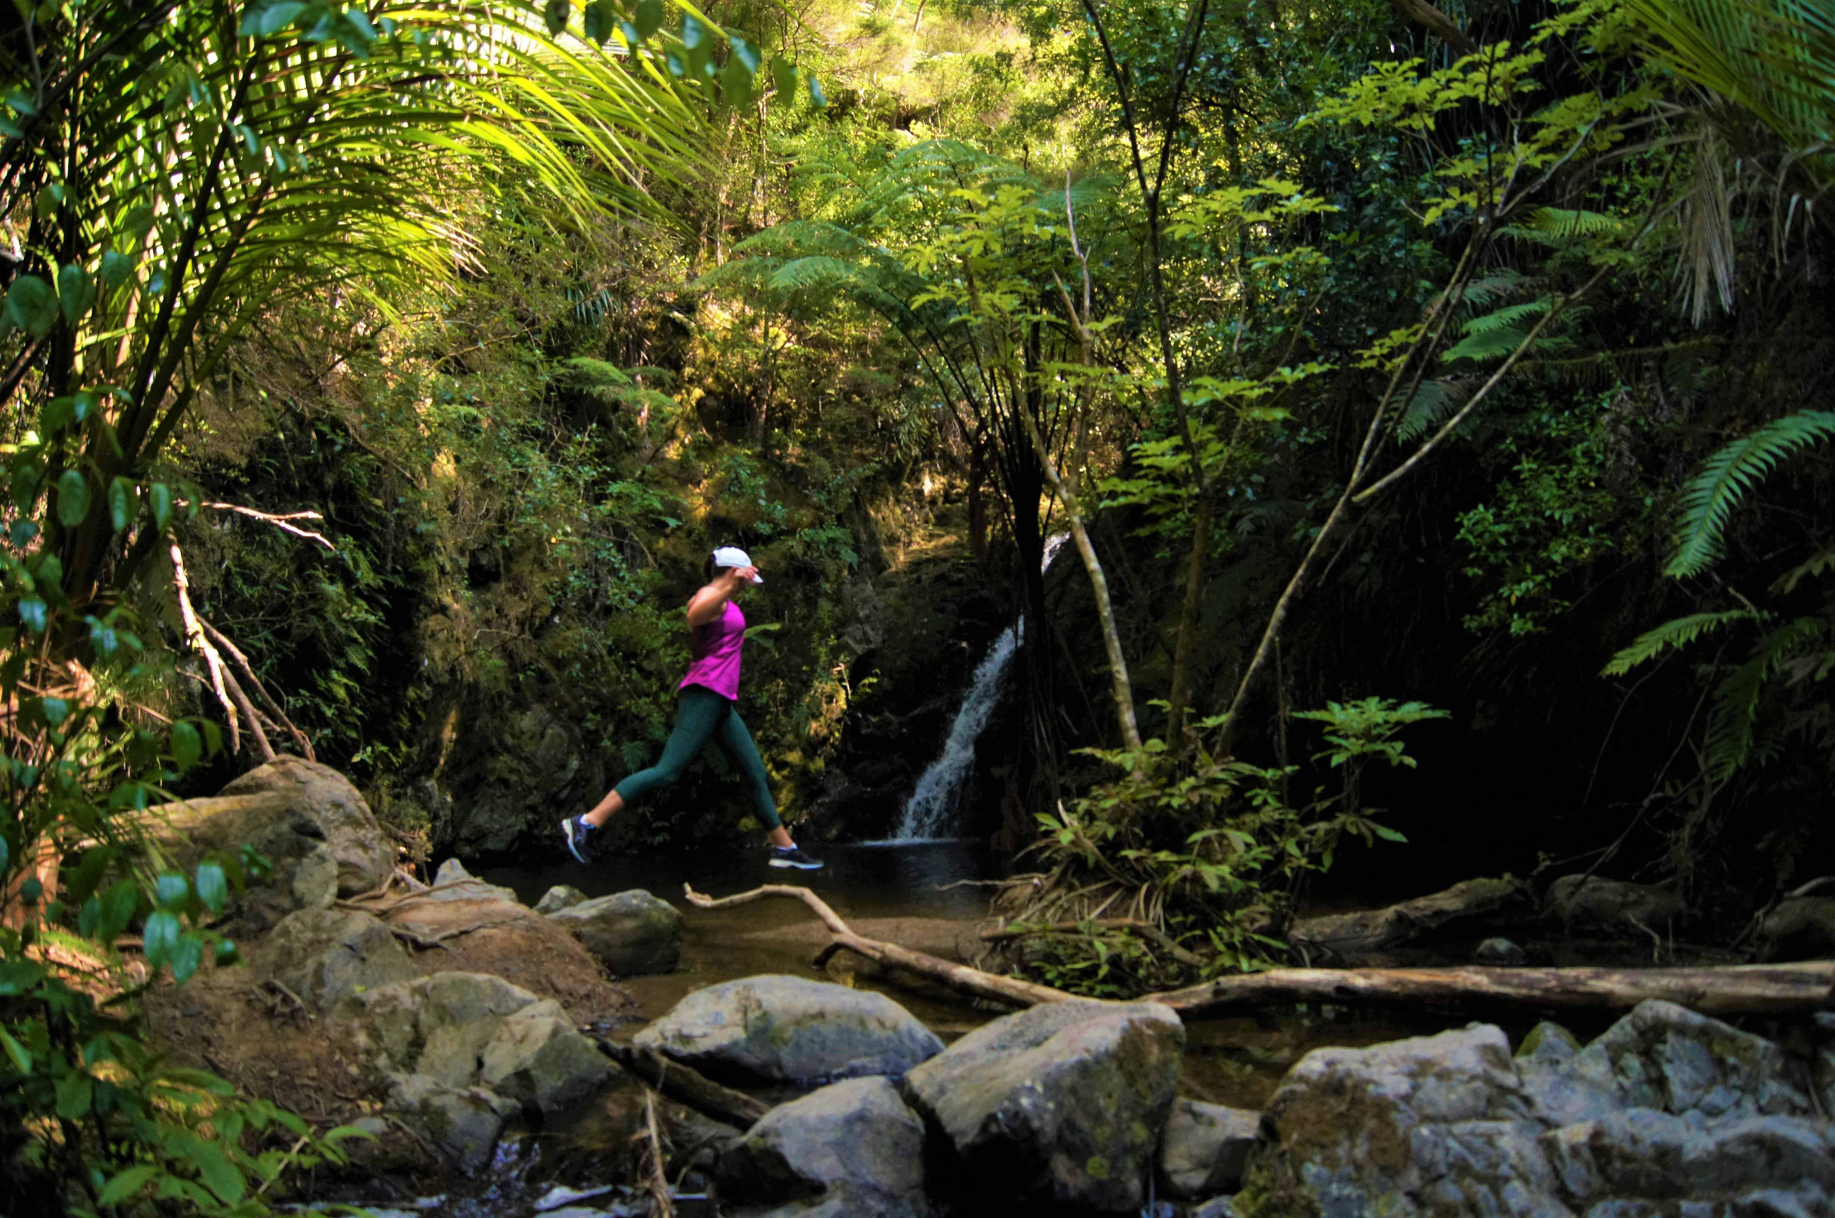
Representation Review Kaipara District Council

Slide 2
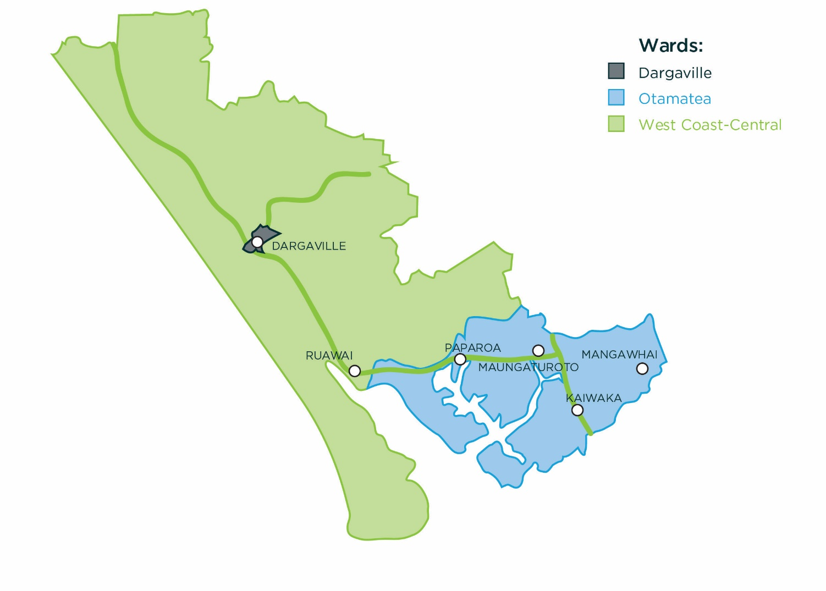
Context
Pop: ~4200
Pop: ~3700
Dargaville – Mangawhai
94km
1.5hr

Slide 3
Context
2012 Review was based on Nine Councillors plus Mayor (from existing 3 wards) - 403 submissions received against the increase to 9.
Final proposal was 8 councillors, 3 wards, this was appealed to LGC and determination supported Council’s final proposal.
Currently Otamatea Ward sits over the permitted threshold.

Slide 4
Council process followed (April/May)
30 April – 18 May Informal Consultation/survey
retain wards
8-9 councillors
retain ward names
consider community boards
April 13th first meeting, discussion conversation with EO and EM’s
Decision to undertake Informal consultation
Discussed results from 2012 Review
Discussed possible options and variations

Slide 5
Informal Consultation Results
78 Responses – by Ward Location

Slide 6
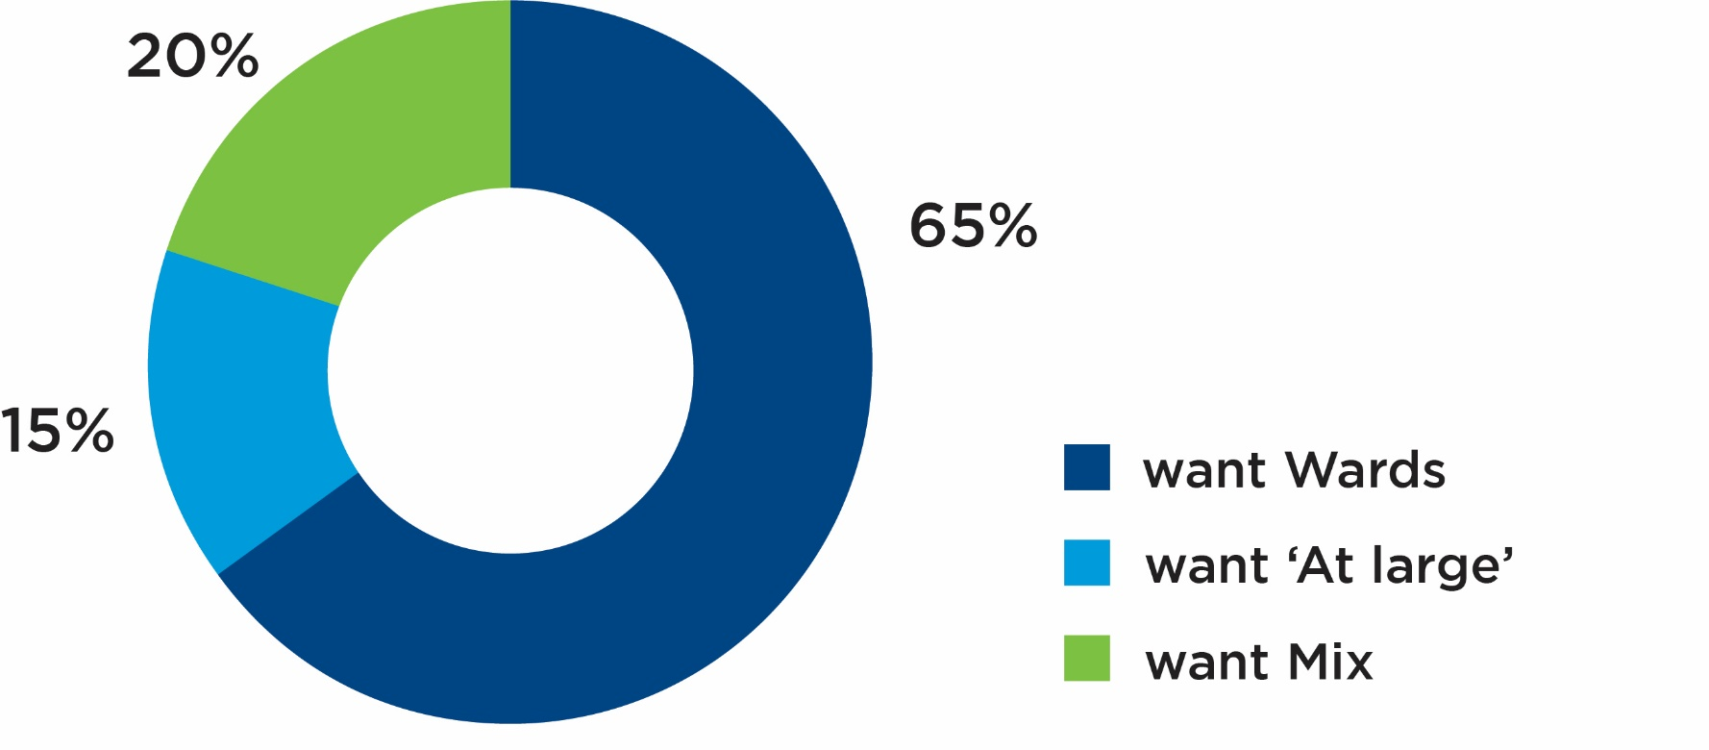
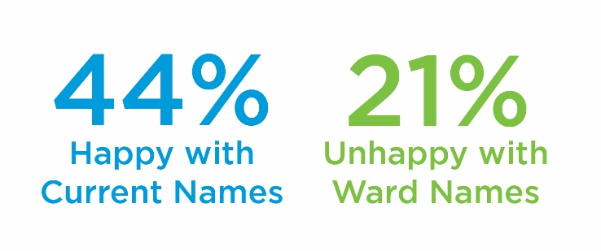
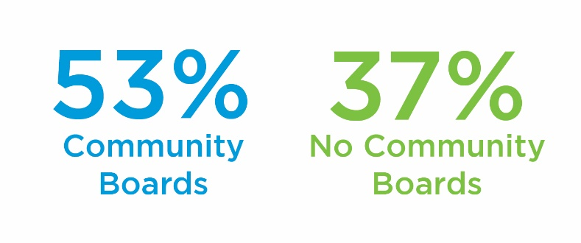
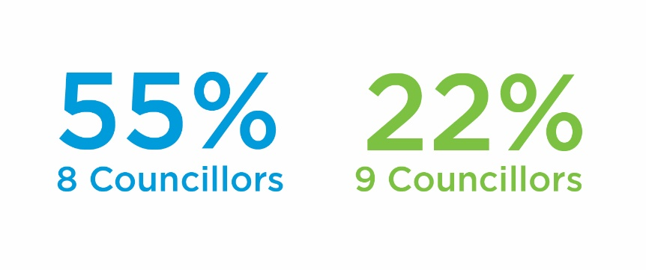
Informal Consultation Results

Slide 7
Summary of Informal Consultation
Retain wards
8-9 councillors
Retain ward names
Consider community boards

Slide 8
Council process followed (May/July)
new Kaiwaka-Mangawhai Ward
8 councillors, 4 wards, no community boards
20 June ’18 Briefing 3 - Initial Proposal Formulated
9 councillors, 4 wards, no community boards
9 councillors, 3 wards, no community boards
8 councillors, 4 wards, no community boards
30 May ’18 Briefing 2 – Refining Options
Discussed out of scope issues
26 July ’18
Council meeting
Initial proposal adopted

Slide 9
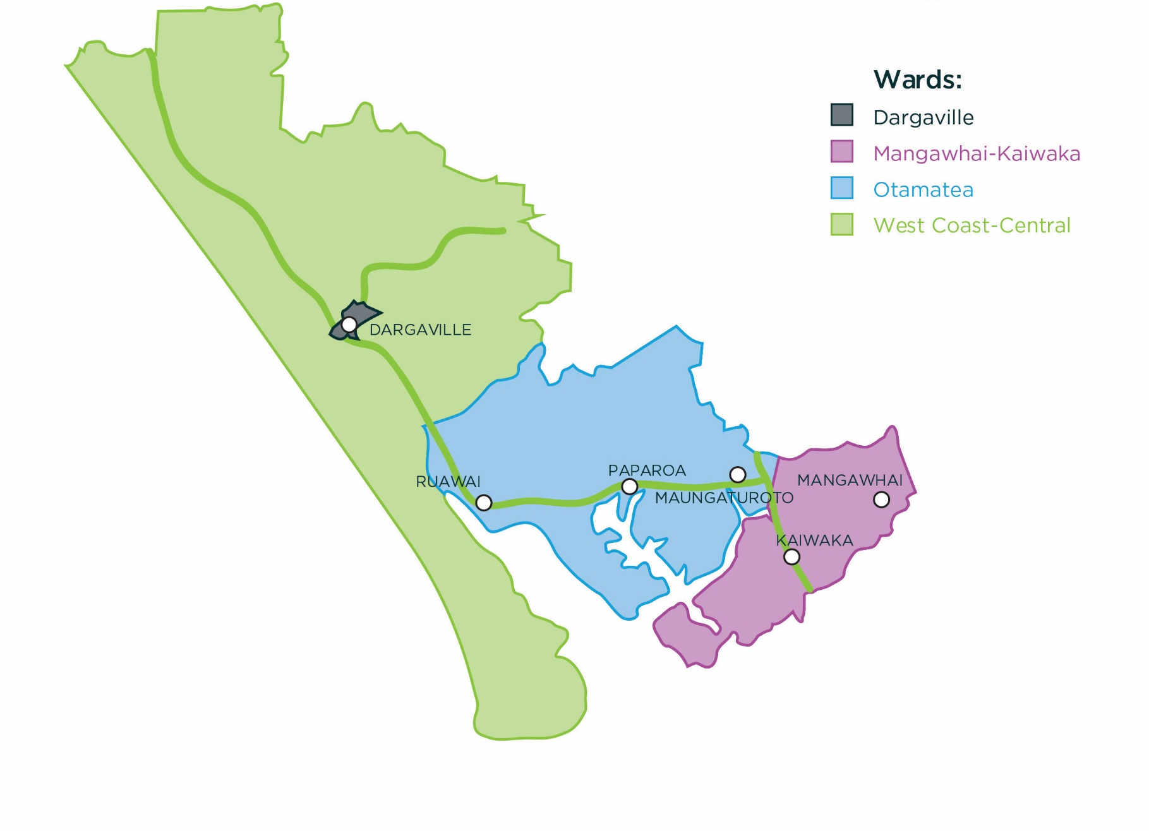
Initial Proposal
Ward | Population | Councillors | Average | Fits Rule | % Variation
Dargaville | 5,080 | 2 | 2,540 | Yes | -9.93%
Otamatea | 5,480 | 2 | 2,740 | Yes | -2.84%
West Coast - Central | 5,830 | 2 | 2,915 | Yes | +3.37%
Kaiwaka - Mangawhai | 6,170 | 2 | 3,085 | Yes | +9.40%
Total | 22,560 | 8

Slide 10
Initial Proposal
Reasons for the proposal –
An extra ward would service communities of interest in the South-East;
Have historic land use and shared local history of the wards;
Matches shared facilities such as marae, shops & recreational facilities.
Factors influencing initial proposal –
Restricted to 2017 population data (as an estimate from 2013 census);
Can not plan for future growth (what is there now, not what is expected to be);
Non-permanent population can’t be factored in (high summer time residents in South-East);
Given opposition to extra Councillor in 2012, an added councillor was unlikely to gain support.

Slide 11
Council process followed (August)
August 2018 - Submission Period
Statement of Proposals available
Drop in sessions across district
Over 300 Initial Proposal documents handed out

Slide 12
Submissions Received

Slide 13
Submissions to Initial Proposal
Support –
makes sense (sensible boundary alterations)
allows for better and fair local representation
support for new Kaiwaka-Mangawhai Ward
new ward be called ‘Eastern Ward’
Oppose –
east/west imbalance not adequately addressed
Mangawhai (fastest growing area) not adequately represented
Mangawhai rating revenue supports greater representation (not part of review)
use of outdated population data
communities of interest not appropriately recognised (Kaiwaka/Maungaturoto, Ruawai etc)
proposal undemocratic (not providing equal or fair representation)

Slide 14
Council process followed (September/October)
09 October 2018 – Extraordinary Council meeting
Final Proposal adoption
11 September 2018 –
Hearing held
6 submitters presented to Council
21 September – Briefing 4
Consider submissions and discuss
Discuss possible alternatives and other options

Slide 15
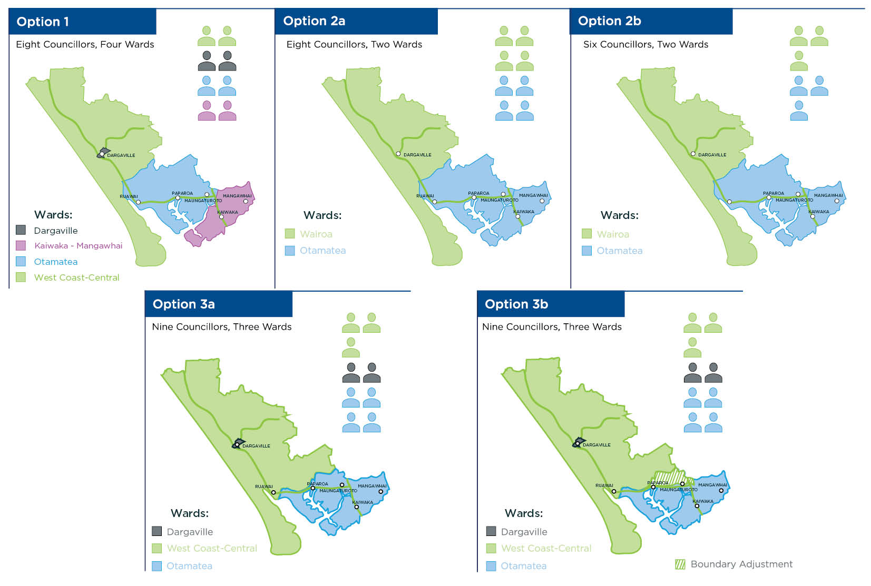
Alternative Options

Slide 16
Final Proposal
Four ward structure addressed East/West divide, while maintaining communities of interest
Eight councillors provides fair and equal representation plus work load
Final Proposal adopted at Council Meeting October 9 2018
The new Kaiwaka – Mangawhai ward provides representation to the growing South-east
Followed due process

Slide 17
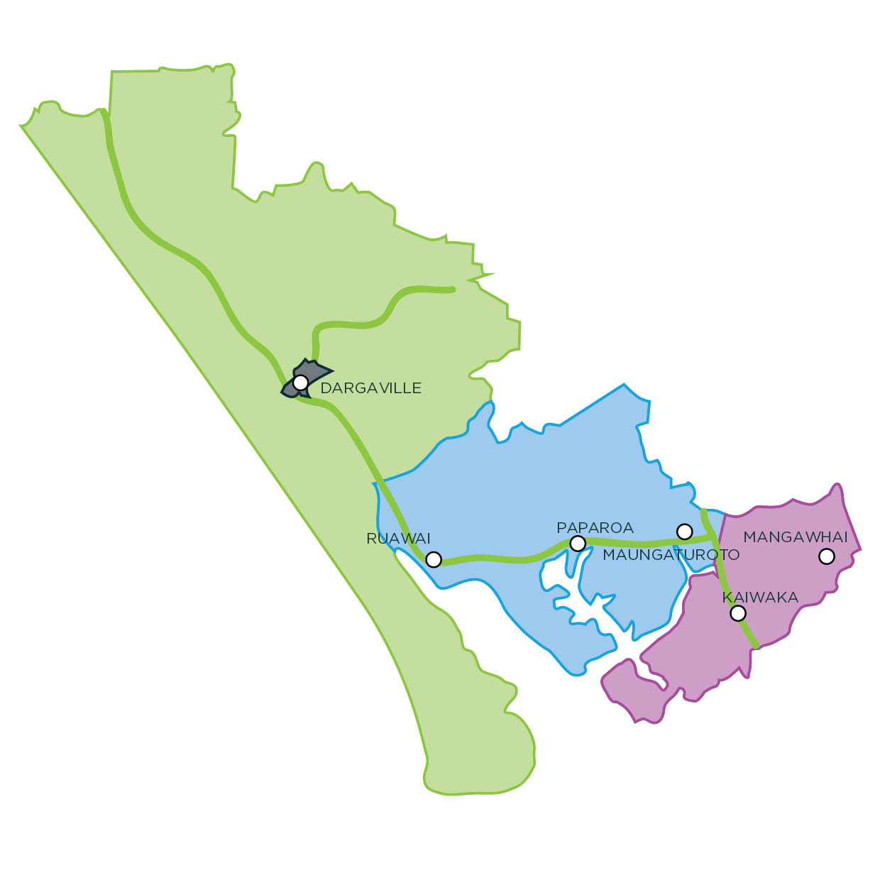
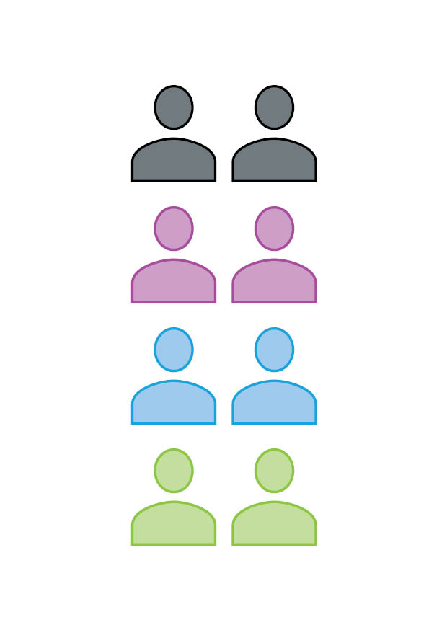
Final Proposal

